Slide 1




Slide 2
Train your own GPT
Notes:
Hello and welcome, in this video we will start to dive into the components of the internal structure of transformers.

Slide 3
What will we learn?
Using GPT-2 model
Get a deeper look inside model’s different functions for training.

Slide 4

1. Select and download the training Corpus
The Dataset
Notes:
Training on a much bigger → more general language generation.
Our goal is to show you that is possible to train your own GPT.
Use Byte Pair Encoding(BPE) as a subword tokenization algorithm.
→ Journey to the Center of The Earth
!wget https://www.gutenberg.org/cache/epub/18857/pg18857.txt
!pip install tokenizers transformers

Slide 5
2. Train the Tokenizer (BPE)
1. Train the Byte Pair Encoding tokenizer for GPT-2 on a corpus:
from tokenizers import models , Tokenizer, decoders , pre_tokenizers , trainers , normalizers
tokenizer = Tokenizer(models.BPE())
tokenizer_normalizer = normalizers.Sequence([normalizers.Lowercase()])
tokenizer.pre_tokenizer = pre_tokenizers.ByteLevel()
tokenizer.decoder = decoders.ByteLevel()
trainer = trainers.BpeTrainer(
vocab_size=50000,
inital_alphabet= pre_tokenizers.ByteLevel.alphabet(),
special_tokens=[ "<s>", "<pad>", "</s>", "<unk>", "<mask>"])
tokenizer.train(["/content/pg18857.txt"], trainer)
! mkdir our_GPT_tokenizer
tokenizer.save("our_GPT_tokenizer/tokenizer.json")

Slide 6
3. Preprocess the Corpus using our tokenizer
Load tokenizer
from transformers import GPT2TokenizerFast, GPT2Config, TFGPT2LMHeadModel
our_tokenizer = GPT2TokenizerFast.from_pretrained("our_GPT_tokenizer")
our_tokenizer.add_special_tokens({ "eos_token“ : "</s>", "bos_token“ : "<s>“ , "unk_token“ : "<unk>", "pad_token“ : "<pad>", "mask_token": "<mask>“ })
Test our tokenizer
en = our_tokenizer("<s> Hello AI Mastery </s>")
{'input_ids': [0, 148, 118, 51, 83, 45, 91, 111, 1696, 72, 2], 'attention_mask': [1, 1, 1, 1, 1, 1, 1, 1, 1, 1, 1]}
Tokenizer Offset tracking → Very useful feature for switching between strings and tokens.
print(our_tokenizer.backend_tokenizer.pre_tokenizer.pre_tokenize_str("<s> Hello AI Mastery </s>"))
[('<', (0, 1)), ('s', (1, 2)), ('>', (2, 3)), ('ĠHello', (3, 9)), ('ĠAI', (9, 12)), ('ĠMastery', (12, 20)), ('Ġ</', (20, 23)), ('s', (23, 24)), ('>', (24, 25))]

Slide 7
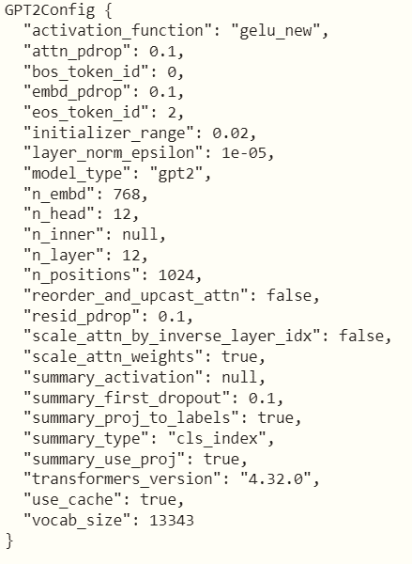
4. GPT Configuration
config = GPT2Config(
vocab_size=our_tokenizer.vocab_size,
bos_token_id=our_tokenizer.bos_token_id,
eos_token_id=our_tokenizer.eos_token_id)
model = TFGPT2LMHeadModel(config)
print(config)

Slide 8
5. Prepare training data
Load file in content variable :
with open("/content/pg18857.txt", "r", encoding='utf-8') as f:
content = f.readlines()
Drop lines < 10 character
Drop ‘\n’
content_p = []
for c in content:
if len(c)>10:
content_p.append(c.strip())
content_p = " ".join(content_p) + our_tokenizer.eos_token

Slide 9
5. Prepare training data
with open("/content/pg18857.txt", "r", encoding='utf-8') as f:
content = f.readlines()
Drop lines < 10 character
Drop ‘\n’
content_p = []
for c in content:
if len(c)>10:
content_p.append(c.strip()
+ our_tokenizer.eos_token )
content_p = " ".join(content_p)

Slide 10
5. Prepare training data
with open("/content/pg18857.txt", "r", encoding='utf-8') as f:
content = f.readlines()
Drop lines < 10 character
Drop ‘\n’
content_p = []
for c in content:
if len(c)>10:
content_p.append(c.strip)
content_p = " ".join(content_p)
+ our_tokenizer.eos_token
Tokenize the whole text .
tokenized_content = our_tokenizer.encode(content_p)

Slide 11
5. Prepare training data
Make the samples for training with a sliding window of size 100 tokens.
sample_len = 100
examples = []
for i in range(0, len(tokenized_content)):
examples.append(tokenized_content[i:i + sample_len])
train_data = []
labels = []
for example in examples:
train_data.append(example[:-1]) # 0 --> 99
labels.append(example[1:]) # 1 --> 100

Slide 12
5. Prepare training data
For faster training, it is required to make the data in the form of a TensorFlow dataset.
import tensorflow as tf
dataset = tf.data.Dataset.from_tensor_slices( (train_data,labels) )
buffer = 100
batch_size = 16
dataset = dataset.shuffle(buffer).batch( batch_size,
drop_remainder=True)
optimizer = tf.keras.optimizers.Adam(learning_rate=3e-5, epsilon=1e-08, clipnorm=1.0)
loss = tf.keras.losses.SparseCategoricalCrossentropy(from_logits=True)
metric = tf.keras.metrics.SparseCategoricalAccuracy('accuracy')
model.compile(optimizer=optimizer, loss=[loss, *[None] * model.config.n_layer], metrics=[metric])

Slide 13
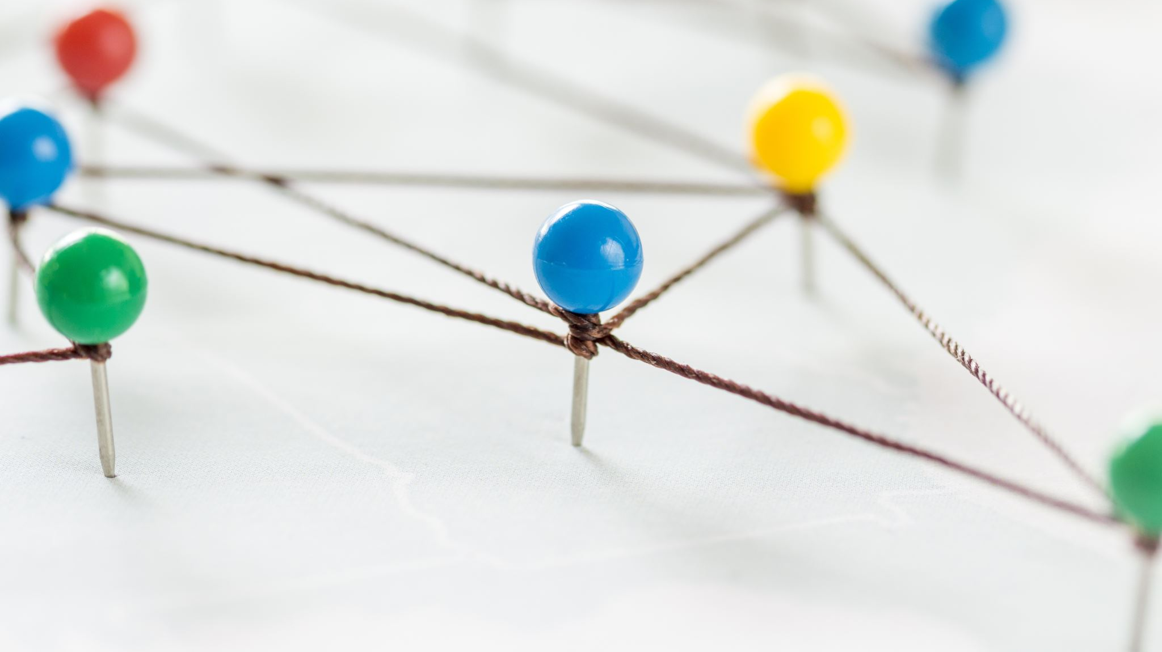

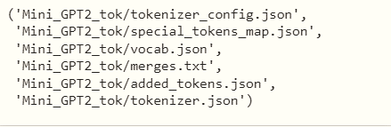
6. Training your GPT
1. Start training with Keras fit method
epochs = 5
model.fit(dataset, epochs=epochs)
2. Save The Checkpoint
model.save_pretrained("Mini_GPT2_model")
3. Save The Tokenizer
from transformers import WEIGHTS_NAME,CONFIG_NAME,TF2_WEIGHTS_NAME
our_tokenizer.save_pretrained("Mini_GPT2_tok")

Slide 14
7. Test: generate text with Mini GPT
from transformers import GPT2TokenizerFast, TFGPT2LMHeadModel
our_tokenizer = GPT2TokenizerFast.from_pretrained("Mini_GPT2_tok")
model_reloaded = TFGPT2LMHeadModel.from_pretrained("Mini_GPT2_model")
def generate(prompt, model):
input_token_ids = our_tokenizer.encode(prompt, return_tensors='tf')
output = model.generate( input_token_ids,
pad_token_id = our_tokenizer.pad_token_id,
eos_token_id = our_tokenizer.eos_token_id,
max_length = 128,
num_beams = 5,
temperature = 0.5,
no_repeat_ngram_size=2,
num_return_sequences=1
)
return tokenizer.decode(output[0])

Slide 15
7. Test: generate text with Mini GPT
generate("it is an exciting idea to make" , model_reloaded)
it is an exciting idea to make a ship. my legs gave way like those of a drunken man. i crawled upon my hands and knees; i hauled myself up slowly, crawling like a snake. presently i closed my eyes, and allowed myself to be dragged upwards. "look around you," said my uncle in a stern voice, "heaven knows what profound abysses you may have to look down. this is excellent cold, i opened my first glance was upwards at the cold fleecy clouds, which as by some optical delusion appeared to swim round. what then did i see? my head began to stand still, while the steeple, the

Slide 16
Summary
The goal of this experiment is to teach you how to train your own text generation model using GPT architecture.
Text generation task itself is not an easy task as it requires a very large training text and huge compute resources for training.
Text generation training task is a time-consuming and high-cost model.

